Slide 1
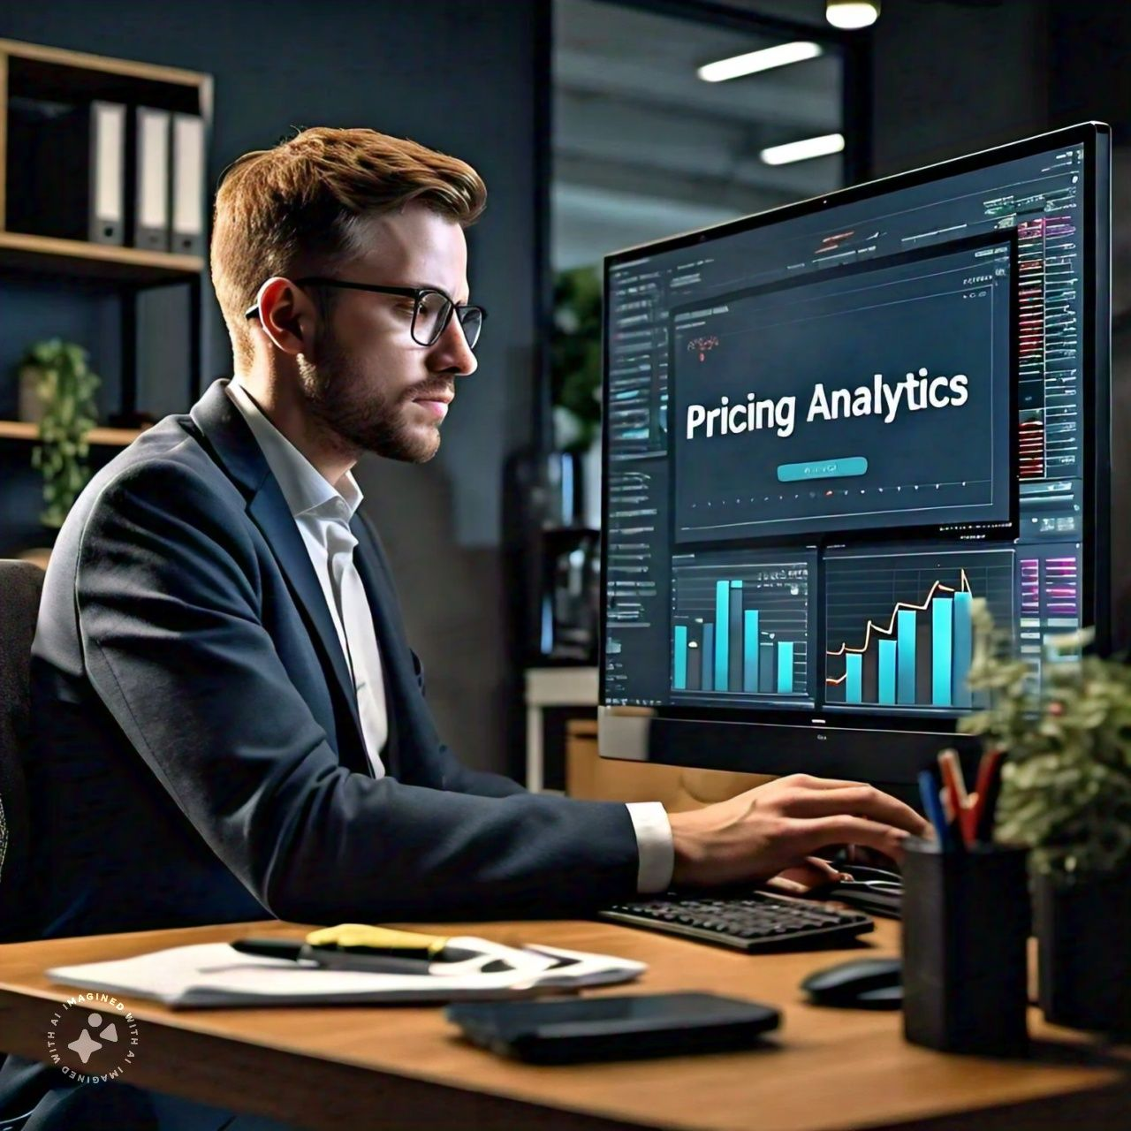
Pricing Analytics
Data Driven Pricing Strategies for
Maximum Profit

Slide 2
What is Pricing Analytics?
Pricing analytics is the process of using data analysis techniques to understand, evaluate, and optimize pricing strategies. It involves analyzing various data points such as historical sales data, market trends, competitor pricing, customer behavior, and other relevant factors to determine the optimal price point for a product or service.

Slide 3
Key Components of Pricing Analytics
Data Collection
Data Analysis
Market data
Customer data
Transactional data
01
02
Statistical Modeling
Machine Learning
Price Optimization
03
04
Performance Monitoring
Algorithm Pricing
Dynamic Pricing
Tracking Revenue
Profitability
Market Share

Slide 4
Applications Of Pricing Analytics
Dynamic Pricing
Price Optimization
1
2
e.g. Airlines and Hotels
e.g. Retail and E-commerce
Value-based Pricing
Competitive Pricing
3
4
e.g. Software and Services.
e.g. Market Analysis and benchmarking

Slide 5
Pricing Analytics Tools & Techniques
1
3
Machine Learning Algorithms，
Simulation & Scenario planning
Regression Analysis
Conjoint Analysis，
2
4

Slide 6
Factors Influencing Pricing Decisions
1
4
Cost of Production
Customer Perception
3
Competitor Pricing
2
5
Market Demand
Market Research

Slide 7
Benefits of Pricing Analytics
Increased revenue and profitability
Improved market competitiveness
Enhanced customer willingness to pay
Data-driven decision-making

Slide 8

Problem Statement
(Price Skimming)
Skimming model of Rolex smartwatch
Cover 12 months of Sales
Sell 10,000 watches
Price adjusted 0n 1st of each month
Assumption: Sell all 10,000 watches in 12 Months

Slide 9
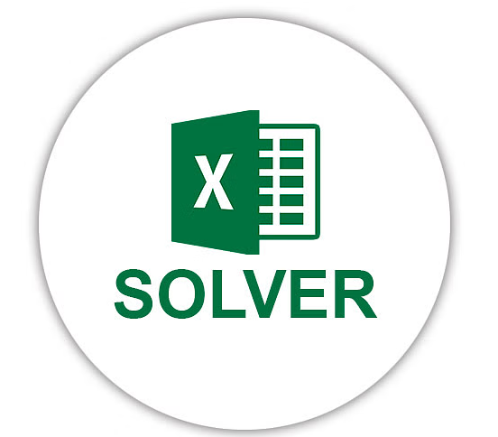
Solve this problem in Excel by using Excel Solver techniques.

Slide 10
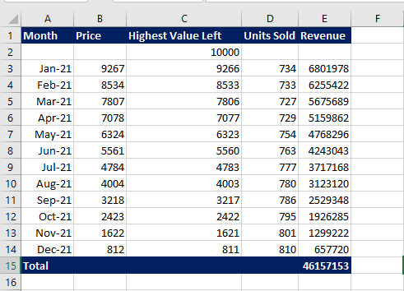

Slide 11
CONCLUSION
In conclusion, by using price skimming through pricing analytics helps companies get the most money from people who buy early or don't mind paying more. They start with high prices and then lower them over time. By looking at data, businesses can figure out the best times to lower prices to attract more customers and still make money. This strategy lets companies enter the market well and keep making profit by adjusting prices smartly.

Slide 12
Thankyou for
your concern

